Slide 1

Creating a form on Google drive
Instructional Presentation by Yoanna Yoon
START
Notes:
Welcome to this class! Today, you will learn how to create a form on Google Drive. “FORMS” is what the survey function is called on Google and it is a free service to anyone who has a Google account. Click START when you’re ready to begin!

Slide 2
objectives
Create new surveys or edit existing forms through Google
Distribute the form link
Access input from the form through Google Drive
NEXT

Slide 3
Home
1: Why Use Forms?
2: Starting a New Form
3: Types of Questions
References
4: Distributing the Form
5: Accessing the Data
6: Downloading the Data
7: Visualizing the Data
Click me to return to this menu at any time.

Slide 4
Why use Forms?
We use Forms because online surveys are one of the quickest and cheapest ways to gather large amounts of data in a fast period. It is much easier to email out a survey to 20,000 people than to interview each of them individually. Google Forms is an easy way to create a survey that can be distributed to any number of people.
NEXT

Slide 5
Creating a new form
To start, log into Google Drive. When you are logged in, click the orange “CREATE” button on the top, left-hand corner. A drop down menu will open up, and you should click the green “FORM” option. If you already have a form created, it will be listed on the Drive page when you log in. If you click open the existing form, you will be able to edit it.
NEXT

Slide 6
Creating a New Form
This is what the top of a new survey looks like. “Untitled form” is the default name of the survey, that is only visible to you. Consider naming this portion something that will help you remember what it is. The “VIEW LIVE FORM” button allows you to see the form as others would when they open up the link to it.
NEXT

Slide 7
Creating a New Form
The two arrows are “UNDO” and “REDO,” respectively, and they undo or redo the last change you made to the document. The survey should be in “EDIT QUESTIONS” mode by default, but clicking the “CHANGE THEME” button allows you to change the visual theme of the survey, or create your own.
NEXT

Slide 8
Creating a New Form
The first one allows the survey takers to see the progress bar as they take the survey. The second setting will only allow the survey takers to take the survey just one time. The last will shuffle the order of questions as they appear.
NEXT

Slide 9
Creating a New Form
“UNTITLED FORM” is the default name of the survey that is visible to everyone. Under “FORM DESCRIPTION” you can add in instructions or other information about the survey that may be important.
NEXT

Slide 10
Creating a New Form
When you are done with the question, the “ADD ITEM” drop down menu allows you to create a new question or add in a “LAYOUT” option, such as a “SECTION HEADER,” “PAGE BREAK,” IMAGE,” or “VIDEO.”
NEXT

Slide 11

Types of Questions
Basic Advanced
Text
Paragraph text
Multiple choice
Checkboxes
Choose from a list
Scale
Grid
Date
Time
NEXT

Slide 12
Basic – Text
The “QUESTION TITLE” box is where you type in your question. The “HELP TEXT” is any extra instructions or details. The three buttons on the right are “EDIT,” “DUPLICATE,” and “DELETE,” respectively. The “REQUIRED QUESTION” checkbox does not allow the question to be skipped. You can mark as many questions as required as necessary.
NEXT

Slide 13
Basic – Text
“TEXT” is a type of question where the survey taker simply types in a short answer to your question.
NEXT

Slide 14
Basic – Paragraph Text
“PARAGRAPH TEXT” is almost the exact same as “TEXT,” but allows the survey taker to submit a longer answer.
NEXT

Slide 15
Basic – Multiple Choice
“MULTIPLE CHOICE” allows you
to display multiple options as
answers and the survey taker
chooses 1 option. The “OTHER”
function allows the survey taker
type in his/her own choice.
NEXT

Slide 16
Basic – Multiple Choice
Under “ADVANCED SETTINGS” you can choose to shuffle the order of the options as they are displayed. The “GO TO PAGE BASED ON ANSWER” option can be used to send the survey taker to a specific page depending on the answers he/she selects.
NEXT

Slide 17
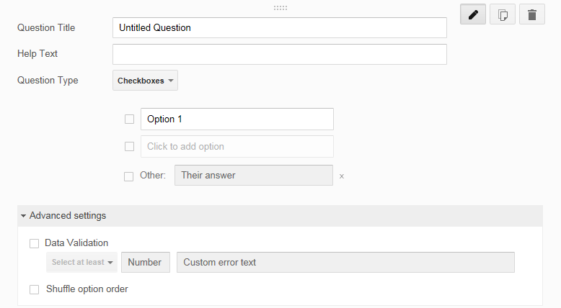
BASIC – Checkboxes
The “CHECKBOXES” is the same as “MULTIPLE CHOICE” but allows the survey taker to select multiple options rather than just one. The “DATA VALIDATION” option at the end can be used to make sure that the survey taker selects a minimum number of options.
NEXT

Slide 18
BASIC – Choose from a List
The final basic type of questions is “CHOOSE FROM A LIST.” This type is similar to the “MULTIPLE CHOICE” and allows your survey taker to select one option from a drop down list of options.
NEXT

Slide 19
Advanced – Scale
The first advanced type of question is “SCALE.” “SCALE” allows the survey taker to select a number from a range, such as a Likert scale. You can change the range of the scale and add in a label for the beginning and the end, such as ‘lowest’ to ‘highest.’
NEXT

Slide 20
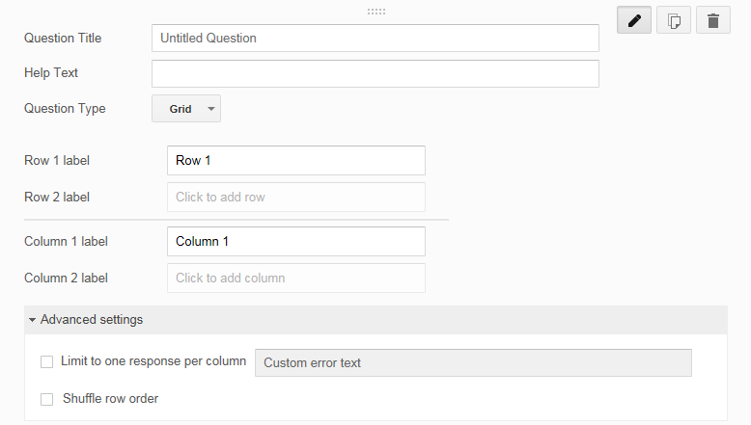
Advanced – Grid
The next type of advanced questions is “GRID.” This type displays the answers in a grid format so that there are corresponding row labels and column labels that the survey taker can choose from. The “ADVANCED SETTINGS” section allows you to limit the type of responses you can get or to shuffle the rows that they survey takers see.
NEXT

Slide 21
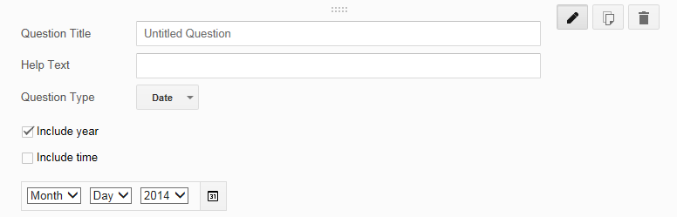
Advanced – Date
“DATE” allows a date as his/her answer. Use the checkboxes to toggle between year and time.
NEXT

Slide 22
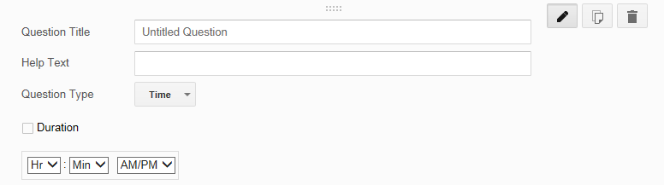
Advanced – Time
“TIME” allows your survey taker to respond to your question with a time. If you check the “DURATION” box, the answer format changes to “HOURS/MINUTES/SECONDS” for a duration of time instead.
NEXT

Slide 23
FLASH QUIZ
What is the correct type of question to use, if you want to ask someone’s birthday?
Scale
Checkboxes
Date
Paragraph Text
Notes:
By the time you complete this activity, you will be able to create and edit surveys on Google, distribute the link to your participants, and also access the data that you collect through your survey on Google. Does anyone have any questions?
****Answer questions as necessary.

Slide 24
Correct!
You would use DATE to ask for someone’s birthday on Google Forms!
Scale
Checkboxes
Date
Paragraph Text
NEXT
Notes:
By the time you complete this activity, you will be able to create and edit surveys on Google, distribute the link to your participants, and also access the data that you collect through your survey on Google. Does anyone have any questions?
****Answer questions as necessary.

Slide 25
Incorrect!
Sorry, you would use DATE to ask someone’s birthday on Google Forms.
Scale
Checkboxes
Date
Paragraph Text
NEXT
Notes:
By the time you complete this activity, you will be able to create and edit surveys on Google, distribute the link to your participants, and also access the data that you collect through your survey on Google. Does anyone have any questions?
****Answer questions as necessary.

Slide 26
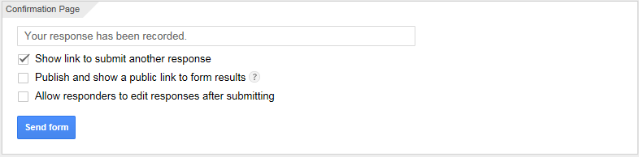
Creating a New Form
In “CONFIRMATION PAGE,” you can type in a custom completion message. The first checkbox is checked by default and allows the survey taker to take the survey again. The second shares the results with those who have taken your survey. Finally, the last option allows your survey taker to go back and change his/her answers, even after they have been submitted.
NEXT

Slide 27
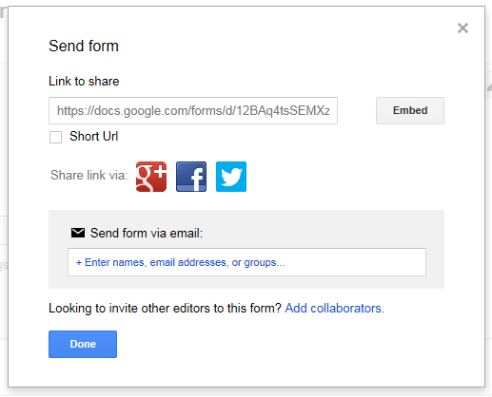
Distributing the Form
You can share the survey link to whomever you want. Clicking the blue “SEND FORM” button at the top right of the page opens up this pop-up box where you can find the link to your survey. The “SHORT URL” option gives you a very short link that can be used for simpler sharing. You can also share the survey through popular social media like Google+, Facebook, and Twitter. You can also directly email the link by typing their emails in the box.
NEXT

Slide 28
Checking the Responses
Clicking the “VIEW RESPONSES” at the top of the page will open up this pop-up. The responses you get through your surveys are automatically kept by Google, but you have to link a new spreadsheet to your survey. This box will name your linked spreadsheet and will be available to open from your main Google Drive page. Clicking “SAVE” will open your new spreadsheet.
NEXT

Slide 29
FLASH QUIZ
Which button allows you to check your responses?
User Input
View Responses
Check Answers
Survey Results

Slide 30
Correct!
You would click VIEW RESPONSES to check your survey results on Google Forms!
User Input
View Responses
Check Answers
Survey Results
NEXT

Slide 31
Incorrect!
Sorry, you click VIEW RESPONSES to check your responses on Google Forms.
User Input
View Responses
Check Answers
Survey Results
NEXT

Slide 32
Downloading the Responses
Clicking “FILE” and going down to “DOWNLOAD AS” will allow you to save the responses as a single file. You can choose from multiple different types of files, the most common being Excel and PDF.
NEXT

Slide 33
Visualizing the Responses
If you want to see your responses in a visual way, a cool function that Google has is the “SHOW SUMMARY OF RESPONSES” function under the “FORM” tab. This will open up a new window with graphs and other ways to interpret the data.
NEXT
Notes:
If you want to see your responses in a visual way, a cool function that Google has is the “SHOW SUMMARY OF RESPONSES” function under the “FORM” tab. This will open up a new window with graphs and other ways to interpret the data.

Slide 34
Congratulations!
You’ve completed the course! Great job.

Slide 35
References
All visuals used in this presentation are from ClipArt or original
screenshots.

